Slide 1
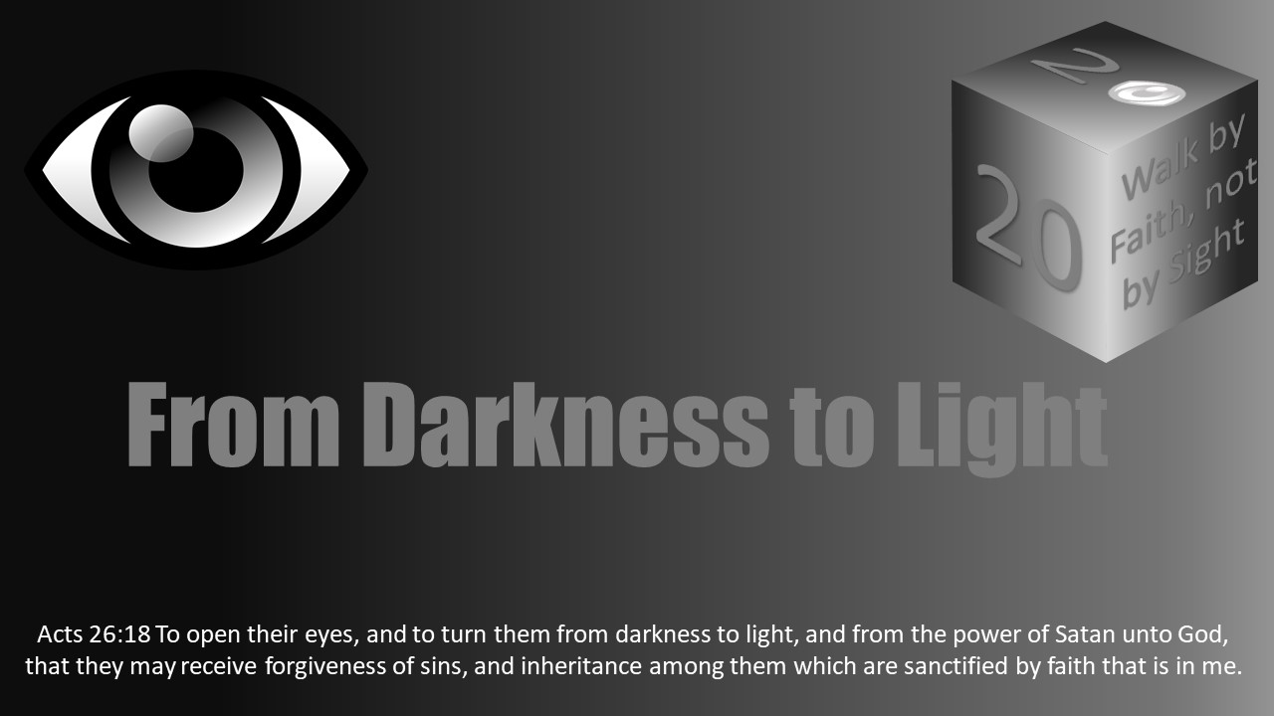


Slide 2
Darkness Lesson 24 GREED

Slide 3
Introduction
In the previous lesson, the author spent a great deal of time accurately depicting the most common understanding and application of “greed.”
Christians can be successful (even financially) without falling prey to the sin of greed, but it requires proper management of attitude and spiritual priorities.
Our attention will focus primarily on the secondary applications of greed in order to better understand how it can impact both our physical and spiritual lives .

Slide 4

Introduction
Our attention will focus primarily on the secondary applications of greed in order to better understand how it can impact both our physical and spiritual lives .
In Robert L. Stevenson’s well-known novel, Treasure Island (1882), the main characters are all driven by their intense desire for treasure. They pursue this desire to the detriment of their own lives and relationships; they are each willing to betray even their friends and comrades along the journey to achieve the rights to the treasure. They are driven, in essence, by that nasty, all-encompassing, ever detrimental greed.
Greed is defined as “a selfish and excessive desire for more of something (such as money) than is needed”[1]. Clearly, this concept can be tied to monetary gain, but should the application cease there for Christians?
[1] Greed. (n.d.). Retrieved November 19, 2018, from https://www.merriam-webster.com/dictionary/greed

Slide 5
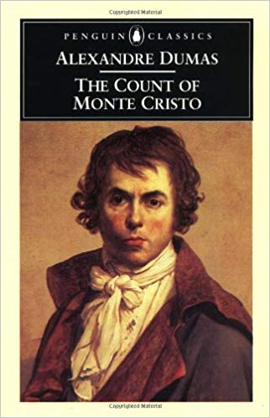
Introduction
Other definitions for greed include an “excessive or rapacious desire, especially for wealth or possessions” and an “excessive desire, as for wealth or power.”[1]
In Consider Alexandre Dumas’ The Count of Monte Cristo (1844), most of the characters are driven by some form of greed, although not all by greed for money. While it is true some do desire great wealth, others prefer power and still others are covetous for unobtainable women.
When we consider the respective novels of Stevenson (1882) and Dumas (1844), it is easy to realize they merely depict normal human nature, or at least human nature as the Devil would have it be. (Reference also Rom 1:18-32 & 2 Tim 3:1-9.)
Like in these fictional narratives, mankind frequently yearns for that which they most often cannot obtain. Wealth, power, fame, and possessions (houses, cars, and even ungodly, carnal relationships) often drive individuals to act contrary to the will of God.
Remember the brothers of Joseph delivered him to be a slave because of their greed for the attention of their father (Gen 37, 39) and the Jews (specifically the priests and elders) handed Jesus over to Pilate because of their own greed and envy of His power (Matt 27:18).
[1] Greed. (n.d.). Retrieved November 19, 2018, from https://www.dictionary.com/browse/greed

Slide 6
Introduction
One of the most misquoted passages in scripture is 1 Timothy 6:10.
Typically, it is quoted as saying “money is the root of all evil.”
However, the text actually reads, “For the love of money is the root of all kinds of evil, for which some have strayed from the faith in their greediness, and pierced themselves through with many sorrows.”
While the difference may seem minute, the stress of the word “love” accentuates the distinction.
Money in and of itself is nothing, but having an overwhelming love for money is what distracts so many individuals from obeying God.
This is equally true of the concepts already briefly mentioned in this introduction.
For example, sexual relationships within the dictates of God’s will are both good and healthy, yet allowing inappropriate sexual relationships to invade your life falls into the same category as having the love of money.

Slide 7
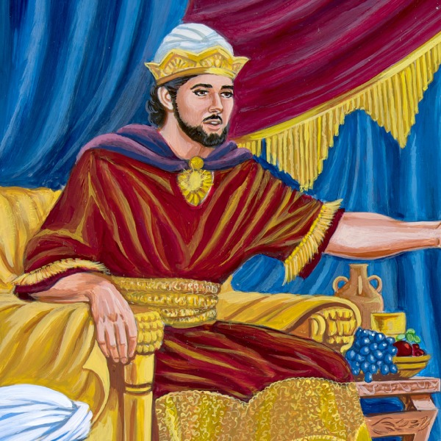
Introduction
The key is to question where the heart really resides.
Does our heart rely on God or does our heart rely on riches, relationships, possessions, fame, power, or the like?
If the heart is in the wrong place, then those elements of our life will lead only to our own destruction. (Reference Psa 37:12-15.)
In Proverbs 1:16-19, King Solomon wrote, “For their feet run to evil, and they make haste to shed blood. Surely, in vain the net is spread in the sight of any bird; but they lie in wait for their own blood, they lurk secretly for their own lives. So are the ways of everyone who is greedy for gain; It takes away the life of its owners” (NKJV).
Likewise, he wrote that “He who is greedy for gain troubles his own house, but he who hates bribes will live” (Prov 15:27).
The unhealthy pursuit of each of these mentioned actions, acquisitions, and relationships will only harm our eternal soul.

Slide 8
Introduction – Up Next
For the remainder of this lesson, let us consider two primary points concerning greed
First, how the greed for power can turn our heads from God.
Second, how greed for fame and popularity distract from God’s goal for our spiritual lives.
We will further consider where our own hearts reside (with God or with the world?) and the futility of the worldly possessions and goals when compared with eternity.

Slide 9
Greed for Power
How would you define “ambition”?
Is ambition always a bad attribute?
Ambition is frequently pushed within modern society as being a positive attribute to have, especially within the business world.
Moderation should be applied even in such circumstances because not all ambition should be considered ungodly.
Ambition is defined as, “an ardent desire for rank, fame, or power,”[1] and ardent means “fiery, hot.”[2]
In other words, the primary definition of ambition denotes an unhealthy desire to achieve something such as “rank, fame, or power.” However, the secondary definition is the “desire to achieve a particular end,” which clearly projects a significantly milder demeanor than the previous definition.
If we carefully control our ambition, then there is certainly nothing wrong with being successful even by worldly standards. We can seek promotions or better our business without crossing the line into unhealthy ambition.
[1] Ambition. (n.d.). Retrieved December 20, 2018, from https://www.merriam-webster.com/dictionary/ambition
[2] Ardent. (n.d.). Retrieved December 20, 2018, from https://www.merriam-webster.com/dictionary/ardent

Slide 10
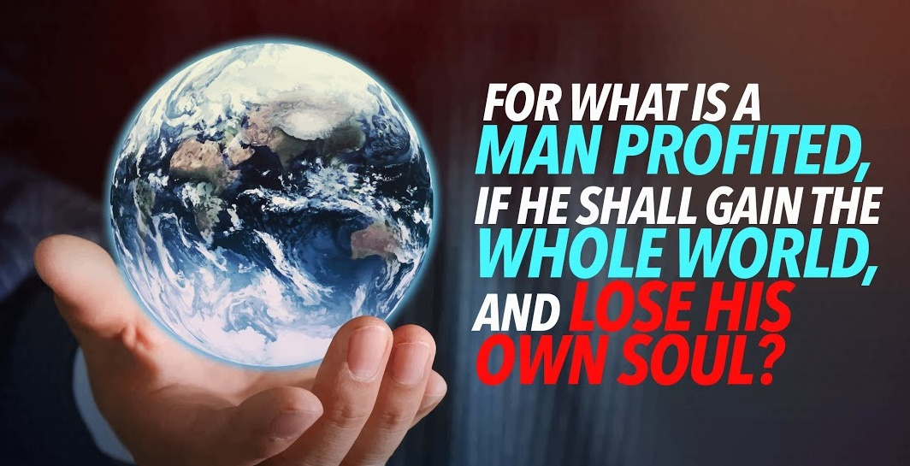
Greed for Power
How might we stray from the acceptable into the unacceptable when it comes to ambition?
In Matthew 16:26, Jesus asked, “For what profit is it to a man if he gains the whole world, and loses his own soul? Or what will a man give in exchange for his soul?”
If we ask ourselves these types of questions, it is easier to discern when we’ve crossed the line into unhealthy ambition.

Slide 11

Greed for Power
Are we willing to sacrifice spiritual things of value in order to obtain that promotion? Or that second car? That boat?
Children were frequently told via word, insinuation, or attitude that they were more intelligent than anyone else (especially anyone within the church), and therefore academics were more important than anything for their eventual financial well-being. Those children are now adults, and very few, if any, are successful by worldly standards. Not a single one is a top expert in their field, nor are any of them professional athletes. While athletics and academics, or similar activities, are not sinful in and of themselves, they can all too easily be turned into sinful actions when we are willing to give up our souls or the souls of our children from them.
SOUL

Slide 12

Greed for Power
Ambition often leads an individual to want to be the most powerful person in their job or in their social groups.
While it may be easy to find an application of the greed for power in the secular world, might it also be applicable within God’s church?
In 3 John 9-10, John stated, “I wrote to the church, but Diotrephes, who loves to have the preeminence among them, does not receive us. Therefore, if I come, I will call to mind his deeds which he does, prating against us with malicious words. And not content with that, he himself does not receive the brethren, but forbids those who wish to, putting them out of the church.”

Slide 13
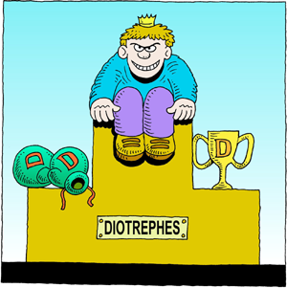
Greed for Power
By definition, preeminent means “having paramount rank, dignity, or importance.”[1]
Did Diotrephes have the authority from God to put others out of the church of his own will?
Note that everything John wrote concerning Diotrephes was negative;
his love of preeminence (power),
his rejection of faithful brethren,
and his prating with malicious words.
Paul wrote that “If a man desires the position of a bishop, he desires a good work” (1 Timothy 3:1).
This desire, however, is balanced out in the context by the qualifications for a bishop (elder) (1 Timothy 3:1-7). This is a healthy desire, not one based upon preeminence and a thirst for power over the brethren
1 Peter 5:3 where we read, “nor as being lords over those entrusted to you [elders], but being examples to the flock…”
The distinction is between the desire to have preeminence (power) and the desire to be a servant (which is the goal of any man desiring to be an elder).
While Diotrephes did not have the authority for his actions, it should be noted a qualified group of elders does have authority over an autonomous group of Christians, much like a shepherd (and thus the connection in Scripture to this concept) has authority over a flock
[1] Preeminent. (n.d.). Retrieved February 23, 2019, from https://www.merriam-webster.com/dictionary/preeminent

Slide 14
Greed for Fame, Popularity, & Blending In
Fame & Evangelists
How might the desire for fame and/or popularity impact the message an evangelist preaches?
The desire for fame is well-known and recognized within the secular world;
Many people jump into acting, singing, or even politics because they want their name to be known in every household.
It seems preachers, teachers, and evangelists could be particularly vulnerable to this desire among brethren.
How many evangelists have fallen prey to wanting to be well-liked and well-known and have, therefore, altered the message of God to accomplish such a worldly goal?
Although we could easily point to TV “evangelists,” such as Joel Osteen or Francis Chan to establish this point. However, it would be beneficial to instead make an application from a personal standpoint.

Slide 15
Greed for Fame, Popularity, & Blending In
How might the desire for fame and/or popularity impact the message an evangelist preaches?
It should be noted the desire to be well-liked is perhaps ingrained in most or all human beings, but what we are willing to do or become in order to obtain this defines who we are.
Even Peter and Barnabas were not above struggling with this issue. Consider Galatians 2:11-13 where the Apostle Paul wrote, “Now when Peter had come to Antioch, I withstood him to his face, because he was to be blamed; for before certain men came from James, he would eat with the Gentiles; but when they came, he withdrew and separated himself, fearing those who were of the circumcision. And the rest of the Jews also played the hypocrite with him, so that even Barnabas was carried away with their hypocrisy.”
Peter’s desire to be well-liked or included took control over what he knew to be right, and then even Barnabas (known as the “Son of Encouragement” in Acts 4:36) gave in.
The lesson we should each learn from this is if an apostle of Christ could become involved in this, then we are equally as vulnerable.
Being liked is a common human attribute, so the temptation to avoid confrontation will occasionally overcome what we know to be right.
Too often, evangelists will avoid any topic that could be deemed controversial so as not to offend anyone, which in turn means avoiding taking a stand or perhaps even studying that issue.
We should not, as with Peter and Barnabas, be caught up in such hypocrisy;
We are not here to be famous or well-liked, but rather to preach the truth.

Slide 16
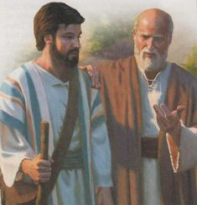
Greed for Fame, Popularity, & Blending In
Paul also warned Timothy that “the time will come when they will not endure sound doctrine, but according to their own desires, because they have itching ears, they will heap up for themselves teachers; and they will turn their ears away from the truth, and be turned aside to fables” (2 Tim 4:3-4).
Although the primary subject of this statement is the hearer/audience who desires a pleasing message, there are other considerations to keep in mind.
For such a pleasing message to be presented, by necessity there must be someone willing to present it.
Additionally, Paul was warning Timothy not to be carried away and become willing to tell people what they wanted to hear rather than what they needed to hear.
Paul charged Timothy “before God and the Lord Jesus Christ, who will judge the living and the dead at His appearing and His kingdom” to “Preach the word!” and to be “ready in season and out of season.”
All of this was to be done in order to be faithful to God, to do His will, and to fulfill Timothy’s ministry. (Reference 2 Tim 4:1-5.)
Contemporary evangelists would do well to adhere to Paul’s advice to Timothy.

Slide 17
Greed for Fame, Popularity, & Blending In
Are we willing to sacrifice our souls or the souls of our children to achieve earthly fame?
Secular Fame & Christians
Are we willing to sacrifice our souls or the souls of our children to achieve earthly fame?
So-called common people are often enamored with the life of celebrities.
Christian parents often push the talents of their children in order for them to make a career in the entertainment industry, and then send them off to New York City or to L.A. to “make it.”
This is often done at the detriment of their spiritual well-being.
No time can be spared to develop them spiritually.
In the greed for fame, how can the ungodly lives of those who have achieved such fame be overlooked?
Some Christian parents encourage their children to achieve such status in this life.
Is this a healthy ambition for a Christian? Is that life really worth the souls of our children?
Too often, Christian parents labor under the false assumption their child will be the exception to the rule, and they will be able to achieve success without tarnishing either their spirituality or their reputation. Such is foolishness; is it worth the risk?

Slide 18
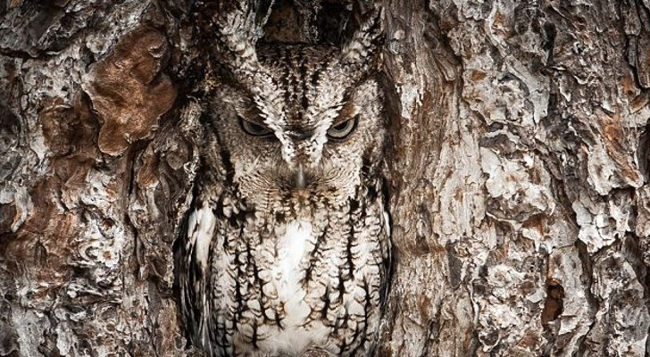
Greed for Fame, Popularity, & Blending In
Christians & Blending In
A threat to Christians everywhere is the desire to blend in with the world rather than being distinct from it.
For many people, arguably even most, wanting to be accepted by friends, co-workers, and peers is a common attribute.
So, going against the grain does not come naturally.
Unfortunately, what all too often happens is this attribute overw
helms God’s commands for Christians to be separate from the world. Some will therefore twist the principles established by Paul in 1 Corinthians 5:9-13 and 1 Corinthians 9:19-23.
Are Christians to pretend to be like the world? Are Christians to portray themselves as being no better off spiritually than those to whom they would preach the Gospel?

Slide 19
Greed for Fame, Popularity, & Blending In
“And my speech and my preaching were not with persuasive words of human wisdom, but in demonstration of the Spirit and of power, that your faith should not be in the wisdom of men but in the power of God.”
1 Corinthians 2:4-5
Is joining in and blending with the world establishes a Christian as a child of God or if it aligns them with Satan?
John wrote, “And now, little children, abide in Him, that when He appears, we may have confidence and not be ashamed before Him at His coming. If you know that He is righteous, you know that everyone who practices righteousness is born of Him” (1 John 2:28-29).
Are we the children of God, or are we the children of the Devil?
John also wrote that “In this the children of God and the children of the devil are manifest: Whoever does not practice righteousness is not of God, nor is he who does not love his brother” (1 John 3:10).
Should we not, as the children of God, want to be recognized as such? What has the world offered to us that can be compared to what the Lord has offered to us?
“Behold what manner of love the Father has bestowed on us, that we should be called children of God! Therefore, the world does not know us, because it did not know Him” (1 John 3:1).
When comparing the love of the world with the love of God, the world certainly falls short each and every time.
Notes:
Under the guise of “not offending” the world, some Christians argue we should “blend in” with the world.
Each year, there are numerous marches for “rights” that take place in both Washington, D.C. and around the country.
One such march was the “Women’s March” in which the following ideologies were promulgated: homosexuality, transgenderism, and “reproductive rights and justice,” among other agenda driven goals.
Some Christians chose to drive hundreds of miles in order to participate in this event and proudly wielded signs declaring not just their “tolerance” for the aforementioned ideologies, but their support of them.
These Christians argued this approach should be used in hopes someone might eventually obey the Lord.
Therefore, homosexual/transgender and “reproductive” rights were “stood up for” in the name of Christ. Additionally, these Christians argued this is exactly what Christ would want them to do and the Bible supported this perspective.

Slide 20
Greed for Fame, Popularity, & Blending In
Any opposition to this view was shot down as uncaring, unloving, and uncompassionate.
In 1 Corinthians 5, did the Apostle Paul applaud their tolerance of sin or did he condemn it? The question was clearly answered in the context .
For when they speak great swelling words of emptiness, they allure through the lusts of the flesh…”2 Peter 2:18
“And you are puffed up, and have not rather mourned, that he who has done this deed might be taken away from among you” (1 Corinthians 5:2).
To argue that the Apostle Paul, who was directly inspired by the Lord God Himself, would have condoned this man’s sinful lifestyle would be a blatant twisting of scripture (2 Pet 3:16).

Slide 21
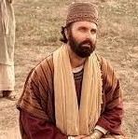
Greed for Fame, Popularity, & Blending In
The argument is often made that Christ would not have wanted to offend those who might become Christians.
It should be asked, do the Scriptures support this claim?
One clear example is that of the “rich young ruler” in Matthew 19:16-22.
Jesus dealt with the specific sin in which the young man was entangled: materialism.
Jesus instructed him on exactly what he would have to do, and that was to give up that which was separating him from God.
The young man “went away sorrowful” because he did not like the answer. Did Jesus change the answer?
Did Jesus comfort this man’s ungodly sorrow? (Reference 2 Cor 7:8-12.)
The message was the same and Jesus did the man the service of being clear and forthright about what obedience would cost him.

Slide 22
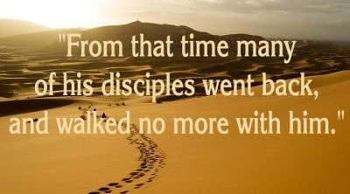
Greed for Fame, Popularity, & Blending In
John 6:60-66 presents another clear example of this principle.
Jesus taught very difficult concepts and the result was the offending of many of His disciples.
In John 6:61, Jesus turned to the twelve and asked, “Does this offend you?”
The indication is that the majority had been “offended” by His teachings, and we are told that from “that time many of His disciples went back and walked with Him no more” (John 6:66).
Those who chose to leave Him at this time were not justified in their walking away merely because He had “offended” them.
Hiding the truth under the guise of “compassion” is not compassionate in the least, but rather it is to the detriment of those who need salvation.

Slide 23
Greed for Fame, Popularity, & Blending In
People argue it is more compassionate to not say anything than to address what sin is in the eyes of God.
Sin is an abomination and not an “alternative lifestyle.” (See Prov 6:12-19 and 2 Pet 2:18-22.)
The Apostle Peter compared sin to “a dog returning to his own vomit” and “a sow, having washed, to her wallowing in the mire.”
This is how God sees sin.
Further, Paul wrote that “the wrath of God is revealed from heaven against all ungodliness and unrighteousness of men, who suppress the truth in unrighteousness” (Rom 1:18).
At what point in God’s wrath has He ever condoned sin? Paul also wrote that “God gave them up to vile passions. For even their women exchanged the natural use for what is against nature. Likewise also the men, leaving the natural use of the woman, burned in their lust for one another, men with men committing what is shameful” (Rom 1:26-27).
While some argue advocating for homosexual “rights” is the moral thing to do, Paul defined these as “vile passions.”
Vile means “morally despicable or abhorrent,” “physically repulsive: foul,” and “disgustingly or utterly bad.”[1]
How can something defined by God as morally despicable, abhorrent, disgustingly and utterly bad be the “moral” thing to advocate?
[1] Vile. (n.d.). Retrieved February 23, 2019, from https://www.merriam-webster.com/dictionary/vile

Slide 24
Greed for Fame, Popularity, & Blending In
Additionally, Paul wrote that “they did not retain God in their knowledge” (Rom 1:28).
If we willfully choose to support sin when God has so clearly condemned it, then we have certainly not retained Him in our knowledge.
Paul continued the thought and wrote that “God gave them over to a debased mind, to do those things which are not fitting,” after which he included a rather extensive list of sins.
Paul did not call these sins “alternative lifestyles,” nor did he depict them as something to be advocated.
Rather, he stated taking part in them was due to a “debased mind” that came from not retaining God in our knowledge.

Slide 25
Greed for Fame, Popularity, & Blending In
But what about supporting those who commit such sins?
Can we not advocate for their “right” to commit these sins in hopes they will one day turn to God?
In Romans 1:32, Paul wrote, “who, knowing the righteous judgment of God, that those who practice such things are deserving of death, not only do the same but also approve of those who practice them.”
Advocating for sin is the approval of sin and clearly fits with what Paul wrote.
Earlier in Romans 1, Paul wrote, “Professing to be wise, they became fools, and changed the glory of the incorruptible God into an image made like corruptible man – and birds and four-footed animals and creeping things. Therefore God also gave them up to uncleanness, in the lusts of their hearts, to dishonor their bodies among themselves, who exchanged the truth of God for the lie, and worshiped and served the creature rather than the Creator, who is blessed forever. Amen” (Rom 1:22-25).

Slide 26

Greed for Fame, Popularity, & Blending In
“For you were once darkness, but now you are light in the Lord. Walk as children of light…” Ephesians 5:8
While some claim moral superiority and great wisdom because they advocate for such “rights,” Paul defined them as “fools” because they have corrupted the glory of God.
They have “exchanged the truth of God for the lie” in an effort to fit in and not “offend” sinful men.
In doing so, they have exchanged God for the worshipping and serving of the lustful desires of mankind.
Why does such happen? As Paul wrote, “because, although they knew God, they did not glorify Him as God, nor were thankful, but became futile in their thoughts, and their foolish hearts were darkened” (Rom 1:21).

Slide 27

Greed for Fame, Popularity, & Blending In
Contrary to an ever increasingly popular argument, standing opposed to sin is not a twisting of Scripture.
The passages utilized here clearly condemn sin and the advocating of such lifestyles, and these are but a few among many. The twisting of Scripture is not, in this instance, found among those condemning such lifestyles, but among those who advocate for them.
For the words of Paul in Romans 1 to be misunderstood, they must be twisted. Peter wrote concerning Paul that “untaught and unstable people twist” his words “to their own destruction, as they do also the rest of the Scriptures” and he then warned us to “beware lest” we “also fall from” our “own steadfastness, being led away with the error of the wicked” (2 Pet 3:16-17).
“Abstain from every form of evil” (1 Thess 5:22 NKJV).
In the KJV, this is translated as “Abstain from all appearance of evil.” Christians cannot advocate for sinful lifestyles and choices without partaking in such evils, and we are foolish to believe such is acceptable to the Lord God above. Such sins are not “what is acceptable to the Lord,” but they are rather “the unfruitful works of darkness,” and it is “shameful even to speak of those things which are done by them in secret” (Ephesians 5:8-14).

Slide 28

Greed for Fame, Popularity, & Blending In
Som Christians would rather blend in with the world than be known as something different.
Are Christians meant to blend in with the world?
In 1 Peter 4:4, the inspired author wrote that in “regard to these [sins], they think it strange that you do not run with them in the same flood of dissipation, speaking evil of you.”
If we blend in with the world, why would they think anything about our lives “strange”?
Why would they speak evil of us if they cannot distinguish between a Christian and a non-Christian?
The Apostle Paul wrote in Galatians 1:1, “For do I now persuade men, or God? Or do I seek to please men? For if I still pleased men, I would not be a bondservant of Christ.”
It is essential we be pleasing to God, which means by necessity the world will not be pleased with our lives, our actions, or our teachings.
We should be more concerned with what is acceptable to God (Eph 5) than we are with pleasing men, and so we should not be greedy for friendship with the world (James 4:4).

Slide 29
Where Your Heart Resides
Where does our heart reside?
Do we daily seek to please the Lord or to please men?
Where does our heart reside? Do we daily seek to please the Lord or to please men?
A prevalent theme throughout the Scriptures concerns where an individual’s heart resides and how they either open it or harden it in relation to the Lord.
In the Old Testament, we are provided with numerous examples where hearts were hardened against the Lord (Exod 8:15, 32, 9:12, etc.).
Paul wrote those who rejected the Lord and therefore “their foolish hearts were darkened” (Rom 1:21).
Examples of the Old Testament kings of Judah, such as Manasseh, Amon, and Josiah.
In 2 Chronicles 34:27, the Lord told Josiah because his “heart was tender” and because he had humbled himself before God, God would reward him by not allowing the punishment of Judah to occur until after his death.
From this example, we can follow the line of thought back to Josiah’s father and grandfather. Of Manasseh, it is written the Lord humbled him, which presumably means his heart as the term is often used in Scripture. (Reference 2 Chronicles 33:10-20.)
Amon, who reigned after Manasseh, “did not humble himself before the Lord, as his father Manasseh had humbled himself; but Amon trespassed more and more” (2 Chron 33:23).
From these examples, we can draw the conclusion we control our heart, and we must keep it from that which can degrade it.

Slide 30
Where Your Heart Resides
“For what profit is it to a man if he gains the whole world, and loses his own soul? Or what will a man give in exchange for his soul?”
Matthew 16:26
Greed can all too easily encompass a Christian’s spiritual life, and our society advocates greed in every aspect of our lives.
Advertising frequently targets consumers by perpetuating the myth that if you have not acquired the fanciest house, the nicest car, and the newest mobile device, you are not as cool, not as successful, and not as valuable to society as those who have attained them.

Slide 31
Where Your Heart Resides
Technology companies sell their customers on needing to upgrade to the latest and greatest technology. They were viewed as successful if they had the latest technology.
In “April 2011, 17-year-old Wang Shangkun made headlines when he sold one of his kidneys so he could buy an iPhone 4 and iPad 2.” However, it is further stated almost “immediately after the surgery, Wang began dealing with complications. Now, nearly eight years later, his decision seems to have cost him his quality of life.” Shangkun now spends every day in bed because his other kidney is failing, which means that he must depend on a dialysis machine. Shangkun brought about this life-long condition for a mere “22,000 yuan, equivalent to $2,500 in the United States.” [1] While we may balk at the extreme nature of this story, it should be remembered the Lord was betrayed for a mere thirty pieces of silver. (Reference Matt 26:14-15, 27:3-5.)
“For what profit is it to a man if he gains the whole world, and loses his own soul? Or what will a man give in exchange for his soul?” Matthew 16:26
[1] Smith, J. (2019, January 23). Man who sold kidney to buy iPhone now bedridden after organ failure. Cleveland News. Retrieved from http://www.cleveland19.com/2019/01/24/man-who-sold-kidney-buy-iphone-now-bedridden-after-organ-failure/

Slide 32
Where Your Heart Resides
Greed, when it is allowed to take control of the heart, will carry the individual to extremes.
There is nothing innately sinful in owning an iPhone, or any other material items such as clothes, purses, shoes, cars, houses, and the like.
However, it must be asked where the heart truly resides. Are we keeping these material possessions in their proper place, or are they taking the place of God?
If our goal is to own such possessions merely for the status symbol they provide, then we need to realign our perspective of this earthly life with God’s view.
“But seek first the kingdom of God and His righteousness, and all these things shall be added to you.” Matthew 6:33

Slide 33

Where Your Heart Resides
In Matthew 6:19-21 (NKJV), Jesus said, “Do no lay up for yourselves treasures on earth, where moth and rust destroy and where thieves break in and steal; but lay up for yourselves treasures in heaven, where neither moth nor rust destroys and where thieves do not break in and steal. For where your treasure is, there your heart will be also.”
Even among Christians, too many parents push their children towards “success” in this life, which generally translates into having lots of money, high-paying jobs, large homes, expensive cars, etc.
In order to achieve this goal, their heart has to be set on carnal ideologies rather than on the spiritual.
What good are these things in the end?
They fade away and nothing is left of them, yet many have neglected salvation for them.
Solomon wrote better “is a little with the fear of the Lord, than great treasure with trouble. Better is a dinner of herbs where love is, than a fatted calf with hatred” (Prov 15:16-17).

Slide 34
Where Your Heart Resides
The underlying concept of Matthew 6:19-21 mirrors that which is found in Proverbs 15:16-17; the amassing of wealth in this life brings trouble to that person because they are constantly worried about thieves and economic downfalls.
Furthermore, many so-called “successful” individuals are devoid of true friends. If their money disappeared, so would the vast majority of their friends.
However, the God-centric person is content with the blessings given them and will, therefore, be happier.
Solomon also wrote that “He who loves silver will not be satisfied with silver; Nor he who loves abundance, with increase. This also is vanity” (Eccl 5:10).
The desire to obtain worldly riches does not bring contentment because it will never be enough.

Slide 35

Where Your Heart Resides
In Ecclesiastes 5:12, it is written that the “sleep of a laboring man is sweet, whether he eats little or much; but the abundance of the rich will not permit him to sleep.”
Initially, there is the worry of trying to obtain the wealth, compounded by the worry of trying to maintain it. And finally, the fear of thieves will interrupt the sleep of the wealthy.
How many rich people hire private security, and why must they do so?
Constant worry over possessions will remain on the earth when they depart.
On this concept, Solomon wrote that “Just exactly as he came, so shall he go. And what profit has he who has labored for the wind? All his days he also eats in darkness, and he has much sorrow and sickness and anger” (Eccl 5:16-17).

Slide 36
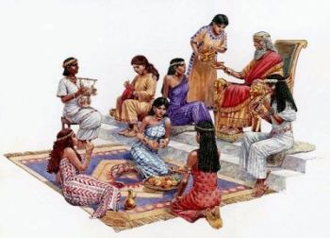
Where Your Heart Resides
When considering greed for possessions, power, fame, and similar things, it is important to consider the life of Solomon.
As he wrote the passages quoted above, it is possible and/or likely he had corrected his previous misdeeds and that he sought to help others avoid the pitfalls that he had fallen prey to.
Of Solomon it is written that “when Solomon was old, that his wives turned his heart after other gods; and his heart was not loyal to the Lord his God, as was the heart of his father David” (1 Kings 11:4).
His greed and indiscretion with ungodly relationships lead him down the path of sinfulness.
Earlier in the same passage, we read that “King Solomon loved many foreign women, as well as the daughter of Pharaoh…from the nations of whom the Lord had said to the children of Israel, ‘You shall not intermarry with them, nor they with you. Surely they will turn away your hearts after their gods.’ Solomon clung to these in love. And he had seven hundred wives, princesses, and three hundred concubines; and his wives turned away his heart” (1 Kings 11:1-3).
Notes:
Although Solomon’s example clearly fits under many different categories, we can easily overlay the definition(s) of greed and see how applicable they are in this circumstance. Remember our definition from Merriam-Webster’s dictionary which states greed is “a selfish and excessive desire for more of something…than is needed.” Even most of the world would acknowledge that having “seven hundred wives, princesses, and three hundred concubines” is most excessive, even though many would disagree with God about having multiple relationships.

Slide 37

Where Your Heart Resides
Where, then, does our heart reside?
Is our heart humbled before the Lord like Josiah’s, or is it prideful like that of Amon?
Are we focused on the greed of this world (fame, fortune, etc.), or are we focused on a spiritual life?
The world will entice us to give up God and to have excessive desires for the things of this world, yet God is openly available to us in order to combat such.

Slide 38

Where Your Heart Resides
In Proverbs 1, Solomon personifies Wisdom and points out that it is readily available.
God does not hide wisdom from us, but rather He has made it readily available in the pages of His word.
Having godly wisdom helps us combat the ungodly desires of this world.
Solomon wrote that “Wisdom calls aloud outside; She raises her voice in the open squares. She cries out in the chief concourses, at the openings of the gates in the city she speaks her words” (Prov 1:20-21).
Why avoid it? Such was the purpose of the writing of Ecclesiastes; Solomon composed it to teach us what he learned through experience so we would not have to experience it personally.
Finally, he wrote that the “Lord gives wisdom; from His mouth come knowledge and understanding; He stores up sound wisdom for the upright; He is a shield to those who walk uprightly; He guards the paths of justice, and preserves the way of His saints. Then you will understand righteousness and justice, Equity and every good path” (Prov 2:6-9).

Slide 39
Futility
“The Lord knows the thoughts of man, that they are futile.” Psalm 94:11
While there is a need to have some money and possessions in this life, an overdependence upon them leads us away from God. Solomon the futility of earthly wealth and accomplishments.
Solomon was an extremely accomplished king in Israel. Of these accomplishments, he wrote of himself, “I made my works great, I built myself houses, and planted myself vineyards. I made myself gardens and orchards, and planted all kinds of fruit trees in them. I made myself water pools from which to water the growing trees of the grove. I acquired male and female servants, and had servants born in my house. Yes, I had greater possessions of herds and flocks than all who were in Jerusalem before me. I also gathered for myself silver and gold and the special treasures of kings and of the provinces. I acquired male and female singers, the delights of the sons of men, and musical instruments of all kinds. So I became great and excelled more than all who were before me in Jerusalem” (Eccl 2:4-9).
During his time and throughout history, Solomon was famous because of his wealth and his accomplishments. This was so much so that many came from all around to see if he was really as wealthy and accomplished as the stories stated. (Reference 2 Chron 9:1-28.)
After acquiring so much wealth, building so much, becoming famous, and possessing so many women, what did Solomon write?
In Ecclesiastes 2:11, he wrote, “Then I looked on all the works that my hands had done and on the labor in which I had toiled; and indeed all was vanity and grasping for the wind. There was no profit under the sun.”

Slide 40
Futility
“For I am not ashamed of the gospel of Christ, for it is the power of God to salvation…” Romans 1:16
In Luke 12:14-21, Jesus said, “But He said to him, “Man, who made Me a judge or an arbitrator over you?” And He said to them, “Take heed and beware of covetousness, for one’s life does not consist in the abundance of the things he possesses.” Then He spoke a parable to them, saying: “The ground of a certain rich man yielded plentifully. And he thought within himself, saying, ‘What shall I do, since I have no room to store my crops?’ So he said, ‘I will do this: I will pull down my barns and build greater, and there I will store all my crops and my goods. And I will say to my soul, “Soul, you have many goods laid up for many years; take your ease; eat, drink, and be merry.”’ But God said to him, ‘Fool! This night your soul will be required of you; then whose will those things be which you have provided?’ “So is he who lays up treasure for himself, and is not rich toward God.”
Our life should not consist of our accumulation of wealth and possessions, but rather of laying up treasure in heaven. The possessions of this life will decay and remain on this earth long after our souls have left it (should the earth persist that long).
What eternal value do they have? What will greed in this life achieve for us?

Slide 41
Conclusion
In Psalm 101:3, King David wrote, “I will set nothing wicked before my eyes; I hate the work of those who fall away; It shall not cling to me.” We can each choose what we set our eyes upon, which will in turn impact the importance of those things in our own spiritual lives.
Likewise, Solomon wrote, “Do not overwork to be rich; because of your own understanding, cease! Will you set your eyes on that which is not? For riches certainly make themselves wings; they fly away like an eagle toward heaven” (Prov 23:4-5).
This echoes the point about the futility of material things in this life that does not carry over into the life that is to come for those who believe in, trust in, and obey Christ.
The Apostle Paul wrote that if “then you were raised with Christ, seek those things which are above, where Christ is, sitting at the right hand of God. Set your mind on things above, not on things on the earth. For you died, and your life is hidden with Christ in God” (Col 3:1-3).
We are to set our eyes on the things from above and focus on what God would have us to do in this life. There is no futility in seeking the things of God, but rather the deepest of meaning. These are true riches! These are the things which persist to eternity!

Slide 42
Conclusion
Do not let the world distract you from obeying and pleasing the Lord God above.
John wrote, “Do not love the world or the things in the world. If anyone loves the world, the love of the Father is not in him. For all that is in the world – the lust of the flesh, the lust of the eyes, and the pride of life – is not of the Father but is of the world. And the world is passing away, and the lust of it; but he who does the will of God abides forever” (1 John 2:15-17).
All those things for which so many strive and waste their lives will fade away, but the true riches of God will never fade.

Slide 43
Conclusion
In Romans 8:31-39, the Apostle Paul presents the fact the Devil and his followers cannot physically remove us from the presence and love of God; we can make the decision to remove ourselves from His presence, but no other entity can do so.
Why would we make such a decision?
Instead, our own attitude should mirror that of John who wrote, “Behold what manner of love the Father has bestowed on us, that we should be called the children of God! Therefore the world does not know us, because it did not know Him” (1 John 3:1).
Let us be known as the children of God, and let us therefore overcome this world and the wicked draw of greed for what it offers. (Reference 1 John 4:4.)

